Slide 1
GCP Component Provisioning Accelerator -iTerraforge

Slide 2
Tool Overview
Building IaC(Infrastructure-as-Code) modules using Terraform for automation of provisioning Apigee X and Apigee Hybrid on GCP .
This is one of key task to perform as part of any Apigee X or Apigee Hybrid project pre-requisite
It will add to our current offering of Apigee X code migration or new implementations
It covers provisioning of GSLB(Global Server Load Balancer), certificates ,MiG (Managed VM) instances, PSC and firewall rules as required for the installation topology
Customers can enhance on top of the tool generated Terraform scripts as required.
The tool targets following propositions
Reduces the amount of efforts required to provision network components through terraform modules; the effort saved is proportional to the skills within Customer group on terraform and GCP.
Provides a industry standard way to provision components along with Apigee X runtime , which allows customers to integrate this with their infrastructure DevOps pipeline
Extensible beyond Apigee , as the tool focus on provisioning GCP component like load balancers, VMs, PSC
There can be multiple variants of topology to provision network component around Apigee X runtime on GCP. Our tool currently covers following most common topologies
Apigee X exposed to internet using Global HTTPS load balancer and PSC NEG
Apigee X exposed to internet using Global HTTPS load balancer and bridge MIG
Apigee X exposed to internet using Global TCP Proxy load balancer and Envoy MIG performing MTLS validation
Apigee X exposed in intranet using Regional TCP Proxy load balancer(s) and Envoy MIG performing MTLS

Slide 3


Apigee X Provisioning Accelerator- iTerraforge
iTerraforge for Apigee X
User plans the topology to provision including instances, environments and environment groups
Then its uses iTerraforge UI to provide the details of topology and configuration
iTerraforge Web UIgenerate terraform variables file from a Web UI
iTerraforge APIs integrated with UI then utilizes the generated config file and create Terraform scripts for the topology
User then run the terraform scripts on their GCP projects.
Apigee X Provisioning UI
API to create Terraform scripts
User enters config details
Config file
Generated Terraform Script
GCP Console – User then run the Terraform modules on GCP console to provision components

Slide 4
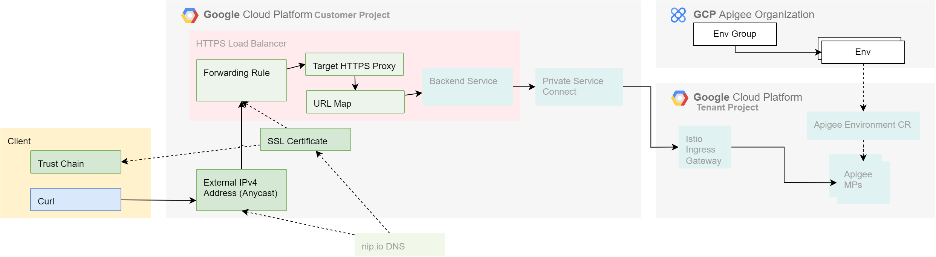
Apigee X Provisioning Accelerator - HTTPS
Component View

Slide 5
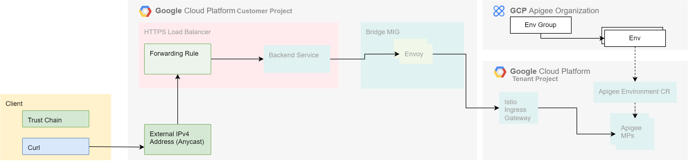
Apigee X Provisioning Accelerator - MTLS
Component View

Slide 6
THANK YOU

Slide 7
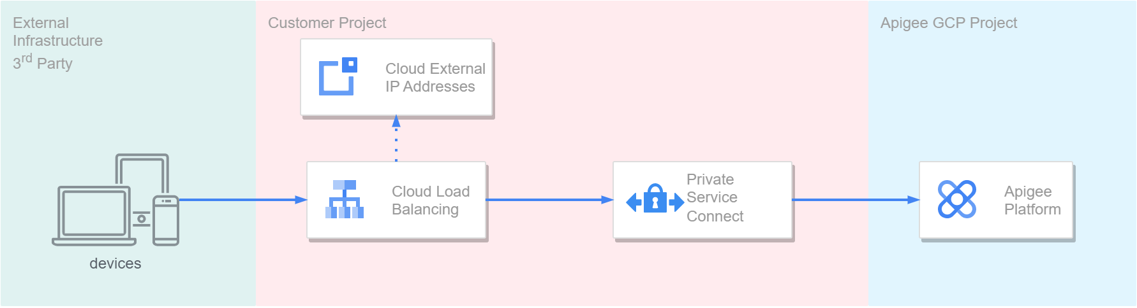
Apigee X Provisioning Accelerator - HTTPS
High Level Architecture

Slide 8
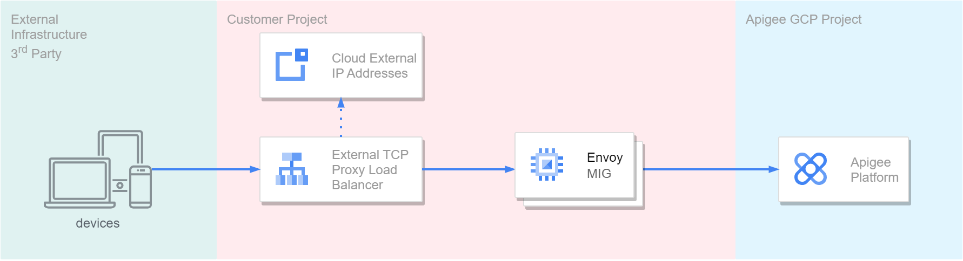
Apigee X Provisioning Accelerator - MTLS
High Level Architecture

Slide 9
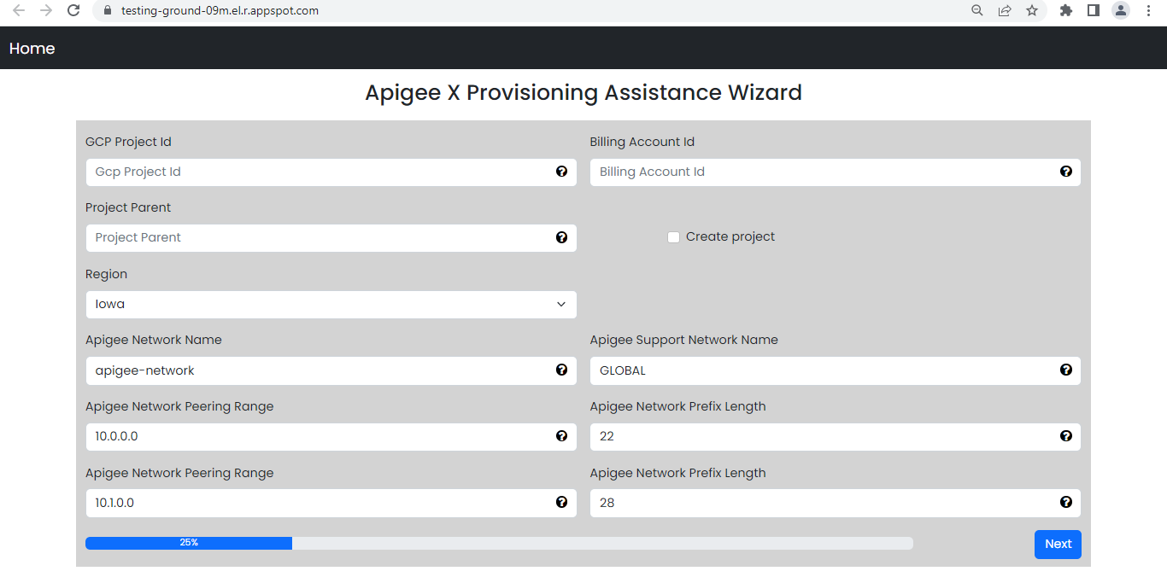
UI for tool

